Slide 1
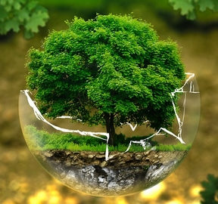
Autecology of species

Slide 2
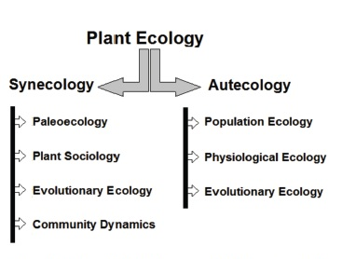

Slide 3
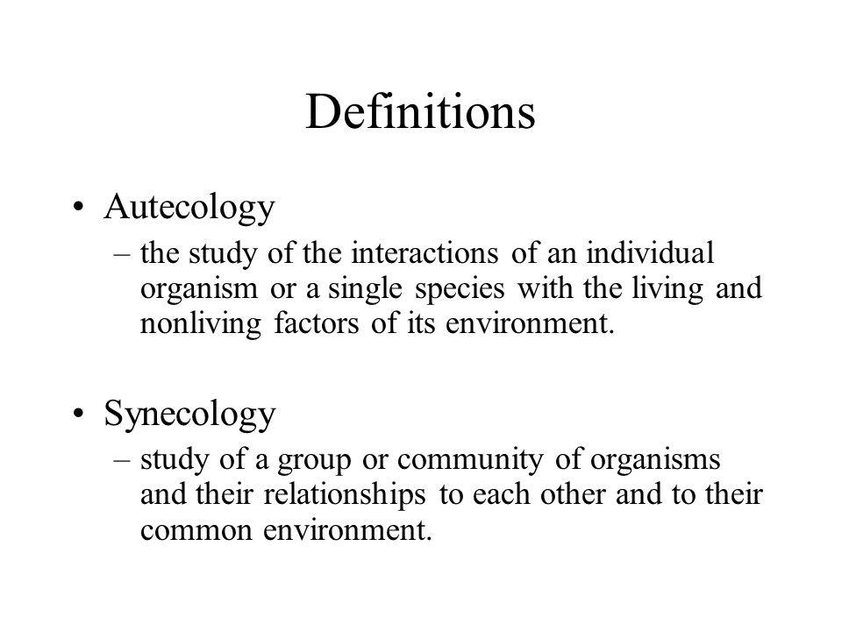
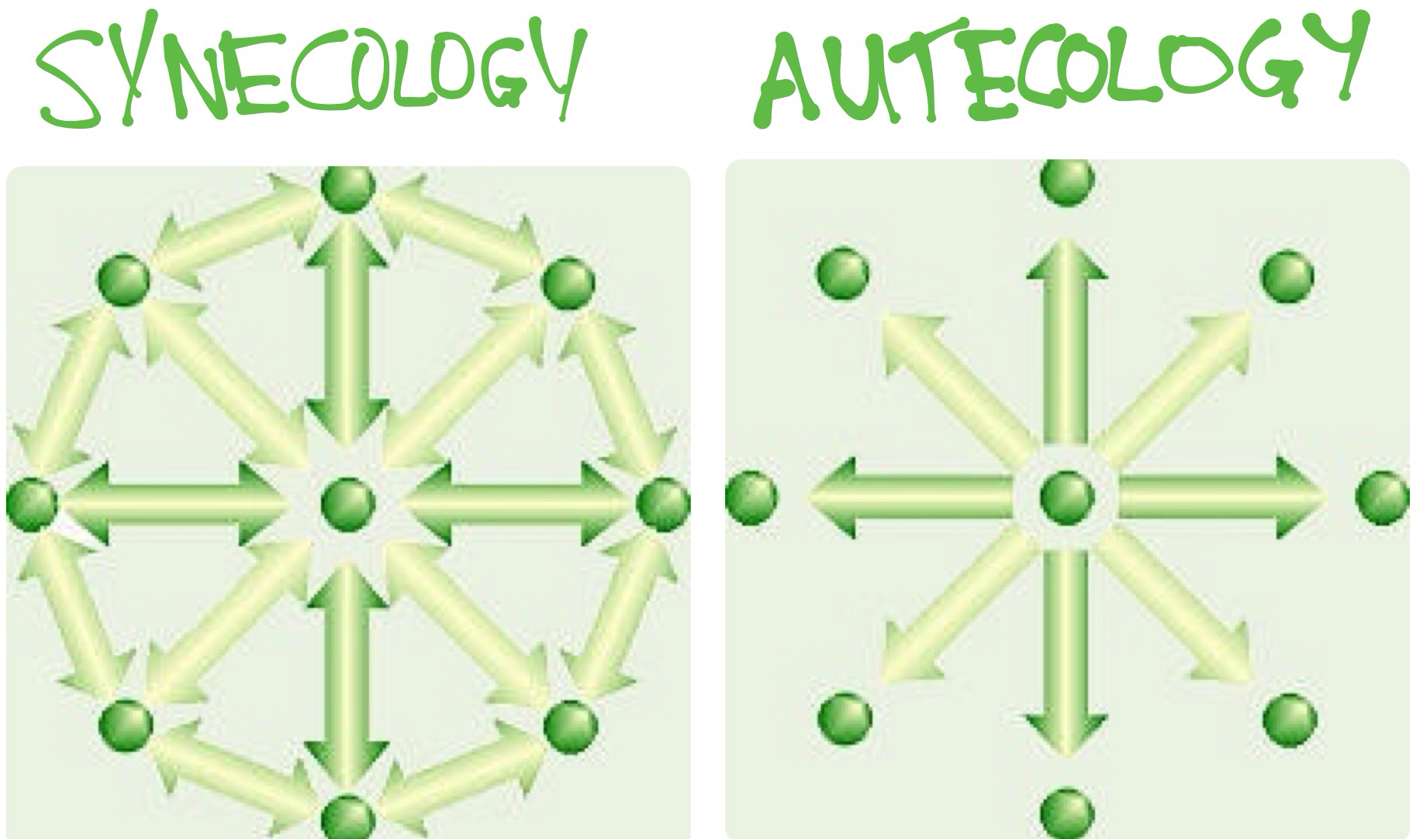

Slide 4
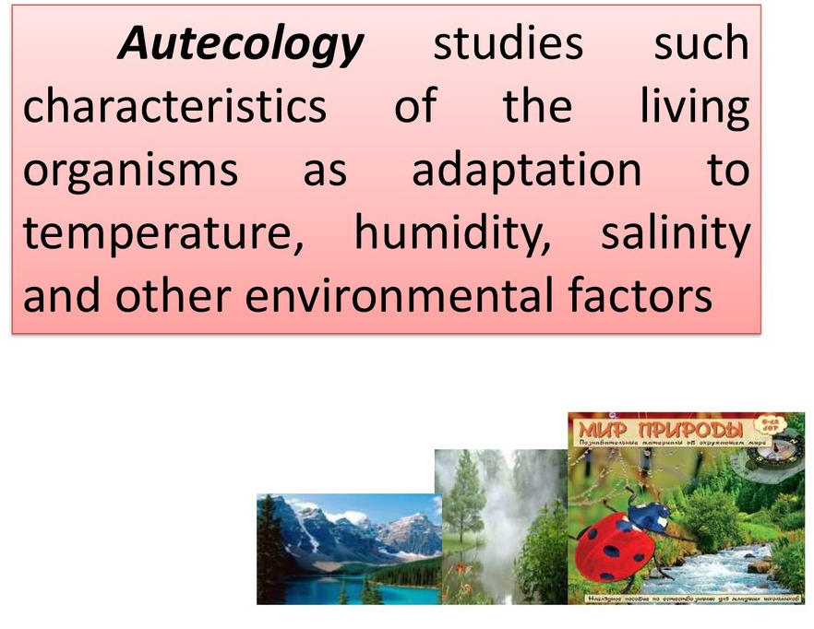
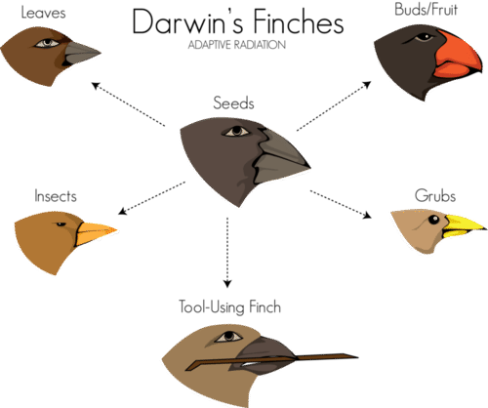
The study of interaction between individuals and its environment is known as autecology.
In autecology, at a given time, we study the influence of individual’s reaction to its natural environment and requirement together and affects of its interacting environment.
In simple words how an organism or single species interacts with its natural environment.
Individual species contribute as the unit of autecology study.
In autecology, we study in detail the morphology of individual effected by its prevailing environment, its geographical distribution based on the surrounding, influence of the environment on the life cycle and growth of organism, its taxonomic position and several factors including those which effects different developmental stages of individual’s life cycle.
For instance, the influence of the change in temperature of surrounding can highly influence the life cycle and development stages of individual.
In brief, lizard, crocodile and several other reptiles can hatch their eggs and sex of the baby is determined by the temperature at the time of hatching.
Darwin working on finches (birds) of Galapagos Island, reported that there is difference in shape and size of beaks of the bird clearly indicating that different finches habiting different area and feeding on different vegetation, evolved to survive and developed beaks of different size and shape.

Slide 5
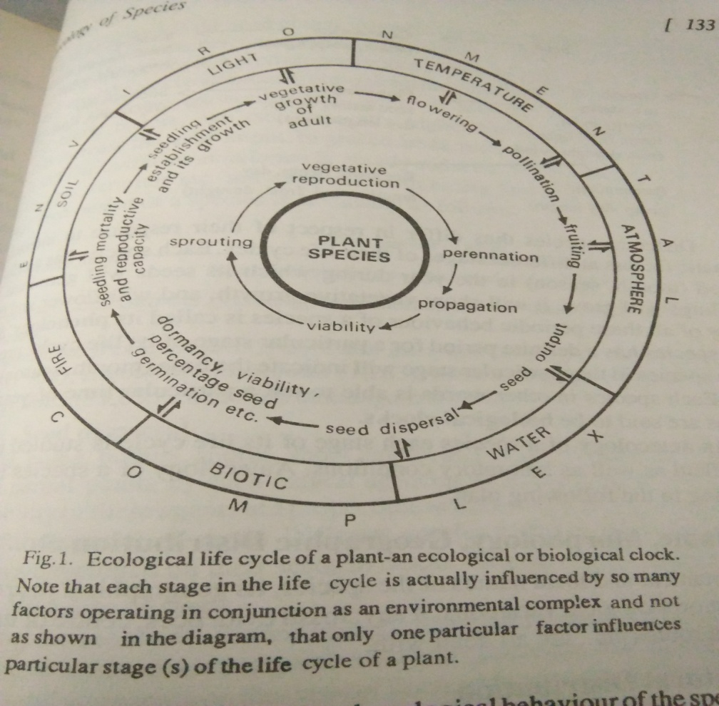
Biological clocks
Each stage in the life cycle of a plant is greatly influenced by a number of environmental factors. The various stages of life cycle of a plant species in nature remain indeed completely embedded in the environmental complex.
The requirement of germination, growth, flowering, fruiting, leaf fall, etc. of the species are met at the same place, but at different times of the year.
There is so much synchronization of the phenological behavior of the species and the different factors of the environment that plants are spoken of as biological clocks or ecological clocks.

Slide 6
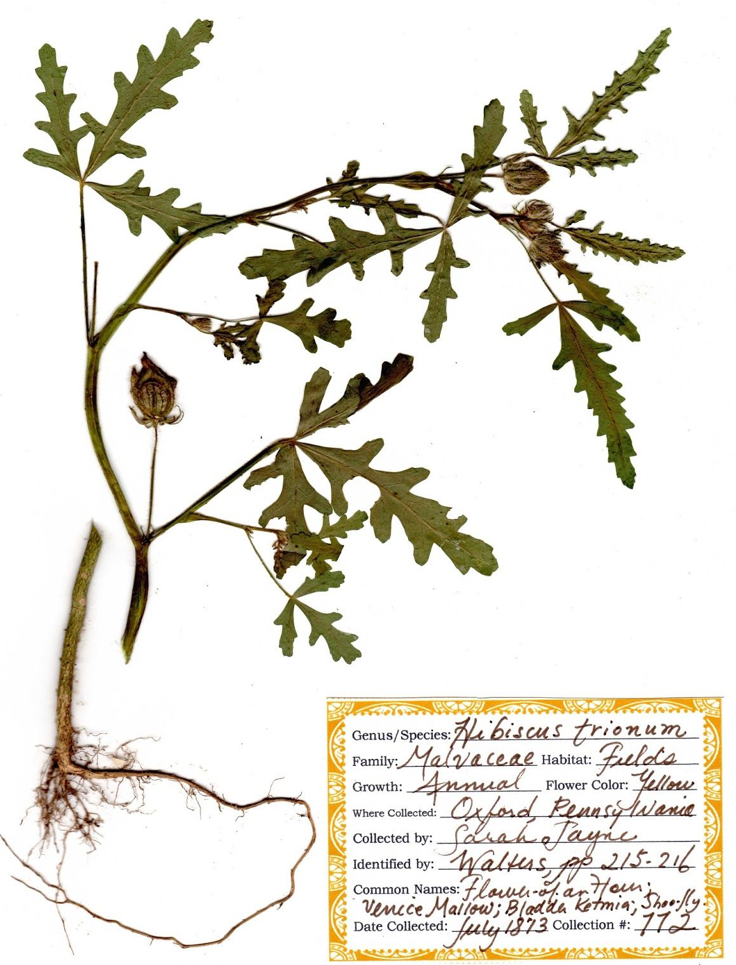
The different aspects in the study of autecology of an individual species are outlined below:
Identification of plants:
Taxonomy and nomenclature of the species under study are discussed. Under nomenclature, scientific valid names, various synonyms and common names are discussed. The confirmation of identification is advisable in a standard regional or central herbarium. The botanical survey of India has developed a chain of herbaria; Central National Herbarium at Shibpur, Howrah, Calcutta and Regional Herbaria at Poona, Coimbatore, Shillong, Dehradun and Allahabad.
Besides, a small Economic plant herbarium exists at Central Botanical Laboratory, Calcutta. These herbaria maintain large collections of correctly identified and properly arranged plants specimens and run a plant identification service.
Associates:
The other species associated with the plant species under study should be recorded in a number of habitat conditions in order to get a proper range of variations. Associate species indicate the sociability and adaptations of a plant.

Slide 7
(2) Distribution and importance:
The range of distribution, altitudinal and latitudinal limits and its ecological importance in various regions and habitats are noted. The degree of dominance or sub-dominance of species in different types of vegetation; its place in succession, whether pioneer or serial member or a component of climax community; its economic importance for browse, timber, pulp, fruits, in erosion and medicine are emphasized.
(3) Morphology of plants:
In this, the distinguishing features of various plant parts are described. Structural variations are also noted in the plants of same species growing on the different ecological habitats.
(4) Cytogenetics of plant species:
Cytological features, such as the structure of cytoplasm, chromosome morphology and the number and behavior of chromosomes during mitosis and meiosis are studied in detail. Sometimes plants of the same species growing geographically isolated become so much differentiated and morphologically changed that they are often supposed as separate species. In such cases, interbreeding experiments are made. If the individuals interbreed, it is supposed that they belong to the same species. Variations in nature and factors for segregation are also discussed.
(5) Physiology of plant:
Various physiological processes of the plants of the particular species are studied in detail and the factors influencing the rates of those processes are also taken into consideration.

Slide 8
(6) Environmental complex:
The life cycle of individual species is greatly influenced by a number of environmental factors operating in conjunction as environmental complex. The various stages of life cycle of plant species in nature remain completely embedded in the environmental complex. Different species differ in respect of their response to climatic factors at different stages of their life cycles.
Each species has a definite time (month or season) in the year for seed germination, seedling growth, vegetative growth, flowering and fruiting etc. Study of all these processes of species in relation to different periods or seasons of the year is called its phenology. Since each species has a definite period for a particular stage of its life history, presence of species in that particular stage will indicate the time of the year.
In other words, the phenological behavior of the species and different environmental factors at different seasons of the year are so much interlinked that the species is said to be in a biological or ecological clock. In autecology of a species, both biotic and abiotic aspects are measured quantitatively at different stages of plant growth at regular intervals in order to study the phenology (germination, leaf- fall, initiation of flower bud, etc.) in relation to different seasons of the year. The environmental complex which is made up of several factors in various combinations affects each stage of plant’s life cycle.

Slide 9
Correlations of phenology to the various environmental changes
(1) Flowering:
Various environmental factors, such as, light, temperature of the soil and atmosphere, percentage of nutrients in the soil, etc. affect the flowering process, of plants. In autecology of a species, the period of flowering as well as the specific roles of different environmental factors on flower initiation, is noted. The photoperiodic effects and temperature effects on the flowering are studied in detail.
(2) Pollination:
During pollination, the environmental factors help the plant to a great extent. Some plants may be pollinated by wind, some by water and some others by biotic agencies, such as insects, birds and even man.
(3) Fruiting:
The structure and number of fruits, number of seeds per fruit, season of fruiting, etc. are some of the important aspects in study of ecological life cycle of a species. The environmental factors by way of their influence on the fruiting of the plants determine the success or failure of particular species of the community in regeneration and establishment. Biotic factors, especially certain disease causing fungi and insects, damage fruits and thus affect fruit formation to a great deal.

Slide 10
4) Seed output:
The number of seeds produced by a plant in one reproductive flux is known as seed output.
The seed output is measured by the following methods:
Counts for seed output are made from the plants growing in a number of diverse localities in order to get a correct assessment. In autecology, the knowledge of seed output is of great importance. It is commonly observed that annuals reproduce only once in their life, whereas the perennial shrubs and trees produce seeds usually once in a year but many times in their life time. Every species has its own range of seed output. The range of seed output may be affected by many habitat factors, both biotic and abiotic. So while taking into consideration the seed output of a particular species, various factors which affect it are also considered.
(5) Dispersal of seeds:
The shape, size, weight and volume of seeds are important characters which govern the mode and extent of dispersal. Distribution and success in the establishment of plant species on the habitats are governed directly by the distribution of their seeds. If all the seeds scattered around the mother plants are allowed to grow, the new plants developing from them will have little chance for survival and regeneration because of over-crowding.
Movement of plant populations to wider areas ensures success in the establishment of species. Thus, the study of dispersal of seeds of plants is one of the important aspects of autecology. The dispersal mechanisms and the agencies causing the dispersal of seeds and other reproductive bodies are also studied in autecology.

Slide 11
(6) Viability of seeds:
Seeds have life spans of their own. They lose their power of germination after some time even if stored under favorable conditions for long period. The period right from their formation up to the time when they begin to lose their germination capacity is called ‘viability period’. This period varies from species to species. In some cases, the viability period is zero and the seeds are totally incapable of germination. To test the viability, seeds are placed in petri dishes on sawdust every week from the day of maturation and seed fall. The experiment is continued till the seeds do not germinate at all.
For calculating the percentage of viable seeds in a given seed sample, seeds are cut and dipped in dilute solution of TTC (tetrazolium trichloride) with a little sucrose. After 24 hours, if the embryos of dipped seeds become pink, such seeds are treated as viable.
The seeds of many crop plants remain viable for 5 to 10 years. In Mimosa glomerata, Cassia bicapsularis and Astragalus massibiensis, the seeds are reported to be viable even after over one hundred years of storage. It is usually seen among the seeds that cannot germinate immediately after formation.
Viability is affected by the conditions prevailing in the particular place where the seed is stored. It has been observed that the conditions which reduce the metabolic activities are usually responsible for increasing the seeds longevity. Low temperature, low oxygen and high CO₂ contents in the atmosphere have marked effects in increasing the viability period of seeds.
(7) Dormancy:
In some cases the viable seeds do not germinate up to a certain length of time even if the conditions for germination are favorable. This period is called dormancy period and such seeds are said to be in dormant stage and this phenomenon is known as dormancy.
Dormancy may be on account of physiological immunity for germination or due to impermeability of seed coat to water and gases or due to specific light requirements or due to the presence of some germination inhibiting substances.

Slide 12
(8) Seed germination and Reproductive capacity:
All the seeds may or may not germinate; some of them are in-viable, some do not get proper conditions for germination and some may be destroyed by living organisms and by excess water. According to Salisbury (1942), the percentage of germinated seeds in the average seed output is called ‘reproductive capacity’.
Reproductive capacity = Average seed output of a plant x Percentage of germinated seeds/100
The reproductive capacity and the seedling establishment are significant for physiognomy (outward appearance) and sociological structures of species population. The process of seed germination is controlled by several factors, such as, temperature, dormancy of seeds, availability of water, concentrations of oxygen and carbon dioxide, pH value of medium and so on. In autecology of a plant species, the different factors which influence the seed germination are also taken into account.

Slide 13
(9) Seedling and vegetative growth:
When mature and viable seeds get favorable conditions for germination, they start germinating and after some time they establish their seedlings. Proper development and growth of seedlings are important factors for the survival of plant. Growth performance of shoot and root in relation to climate, physiography, soil character (physical and chemical both), fire, root/shoot ratio, stomatal counts, their physiology of movements are considered.
Vegetative growth:
Soon after the establishment of seedlings, further growth is chiefly influenced by various environmental factors, related to both soil and aerial environment.
The intensity of solar radiations, durations and quality of light, temperature, soil conditions, water, etc. affect vegetative growth of any species. Every species in a population or community has its own requirements for the environmental conditions and has its own ecological amplitude of tolerance to an extent of fluctuation towards higher and lower sides from the optimum. Interspecific and intraspecific competitions for space, nutrients, light, water, etc. may also wipe out or delay the establishment of seedlings.

Slide 14
(10) Reproductive growth: It includes flowering, pollination and fruiting of a species. Most of terrestrial plants, for their growth , reproduce sexually i.e. flower and fruit. Different species differ in time of their flowering, their light and temperature requirement for flowering and various characteristic of flowers affecting pollination and agencies involved in the process. They also differ in structure and number of fruits, time of their formation and the agencies that damage their fruits.

Slide 15
Law of minimum
Every living organism has limits to the environmental conditions it can endure.
Environmental factors must be within appropriate levels for life to persist.
These factors are primarily responsible for determining the growth and/or reproduction of an organism or population. It may be a physical factor such as temperature or light, a chemical factor such as particular nutrient, or a biological factor such as a competing species. The limiting factor may differ at different times and places.
The Law of Limiting factors states that too much or too little of any abiotic factor can limit or prevent growth of a population of a species in an ecosystem. Examples of limiting factors of a population growth
A. Terrestrial Ecosystem 1. Temperature 2. Water 3. Moisture 4. Soil nutrients B. Marine Ecosystem 1. Salinity 2. Temperature 3. Sunlight 4. Dissolved Oxygen

Slide 16
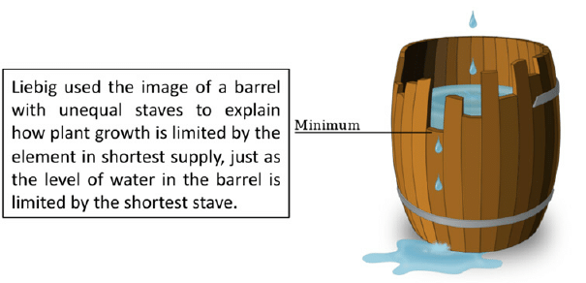
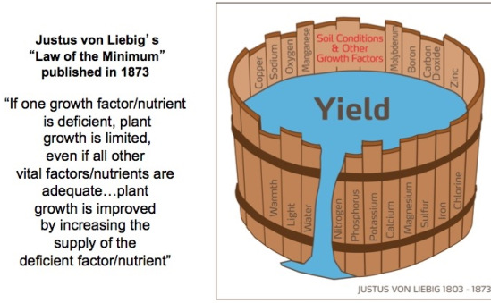
Law of the Minimum
Proposed by Justus von Liebig in 1840. It states that the success of organism determined by crucial ingredient that is in short supply.
Also known as Liebig's Law of Minimum - a system maybe limited by the absence or minimum amount (in terms of that needed) of any required factor.
What this law states is that the rarest requirement of an organism will be the limiting factor to its performance.
As an example, a crop's yield is restricted by the lack of a single element, in this case lets suppose the soil is low in Nitrogen, adding more phosphorus will not improve the crops yield. Once the soil has nitrogen added, crop yield will increase until another element becomes the limiting factor. And no further improvement in yield is possible until more of that element is made available.

Slide 17
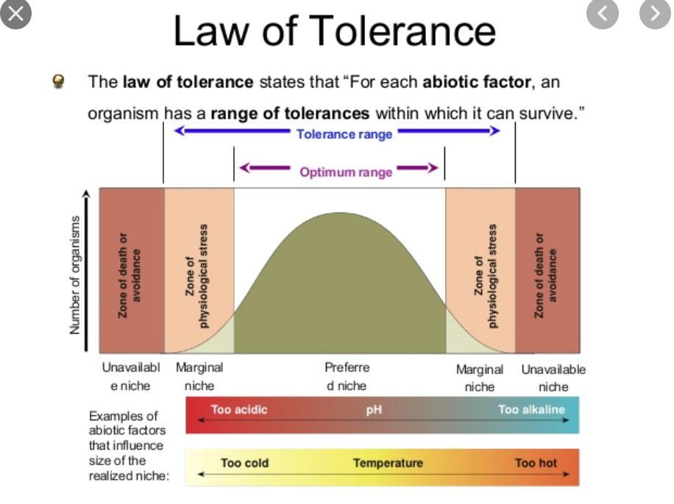
Law of Tolerance
Proposed by Victor Shelford in 1913.
This is an extension of the Law of the Minimum.
It refers to the upper and lower bounds to physical environment an organism can tolerate. These boundaries affect the ability to function, grow and reproduce. These changes can be broad and narrow. There are seasonal shifts in tolerance ranges, but within physiological limits.
Implication - no organism can live everywhere.
The law of Tolerance states that the existence, abundance, and distribution of a species in an ecosystem are determined by whether the levels of one or more physical or chemical factors fall above or below the levels tolerated by the species.

Slide 18
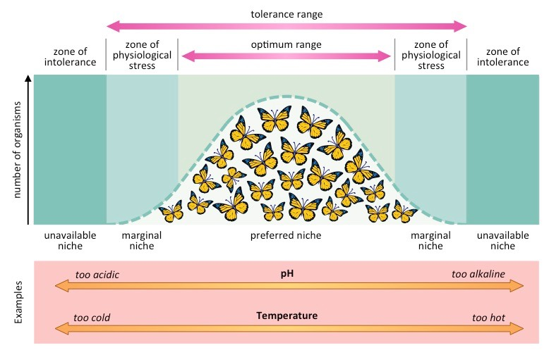

Slide 19
Factor compensation
Organisms in nature are not just slaves to the physical environment; they instead adapt themselves and may even modify the physical environment so as to reduce the limiting effects of temperature, light, water and other physical conditions of existence. Such factor compensation is particularly effective at community level but also occurs within the species.
Species with wide geographical ranges almost develop locally adapted populations called ecotypes that have optima and limits of tolerances adjusted to local conditions. Factor compensation may also involve genetic races (with or without morphological manifestations) or merely physiological acclimation.

Slide 20
Combined concepts of Limiting factors
“The presence and success of an organism or a group of organisms depends upon a complex of conditions. Any condition, which approaches or exceeds the limits of tolerance is said to be a limiting condition or a limiting factor”. (Odum, 1971)
Organisms are controlled in nature by:
The quantity and variability of materials for which there is a minimum requirement and physical factors, which are critical.
The limits of tolerance of the organisms themselves to these factors and other components of the environment.
For e.g. Oxygen is so abundant, constant and readily available to terrestrial organisms whereas it relatively scarce in aquatic environment hence a limiting factor.

